Slide 1
تقديــــــــــــــم:إيمــــــان صلوحـــــة الرقم الجامعي: 220157073 للدكتور الفاضل:أحمــــــد عبد العال
Switch
statement

Slide 2
Another way to control the flow of your programmes is with something called:
“a switch statement”
A switch statement gives you the option to test for a range of values for your variables.

Slide 3
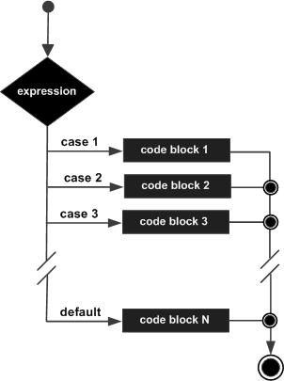

Slide 4
The structure of the switch statement is:
switch(variable_to_test ) { case value: code here break; case n: code here break; default: code here:
values_not_caught_above; }

Slide 5
The variable used in a switch statement can only be:
integers.
Primitive type of integers (byte, short, char).
Strings.

Slide 6
Each case is followed by
the value to be compared to and a colon.
You can have any number of case statements within a switch.
The value for a case must be
the same data type as the variable in the switch

Slide 7
This is how it works:
The switch expression is evaluated once.
The value of the expression is compared with the values of each case.
If there is a match, the associated block of code is executed

Slide 8
The java switch statement is fall-through. It means it executes all statement after first match if break statement is not used with switch cases until a break is reached.
When a break statement is reached, the switch terminates, and the flow of control jumps to the next line following the switch statement.
When reaches a break keyword, it breaks out of the switch block.
A break can save a lot of execution time because it "ignores" the execution of all the rest of the code in the switch block.

Slide 9
A switch statement can have an optional default case, which must appear at the end of the switch.
The default case can be used for performing a task when none of the cases is true.
No break is needed in the default case.
If default is not the last case in the switch block, remember to end the default case with a break.

Slide 10
The switch statement will check the variable and see what's in it.
It will then go through each of the case statements in turn.
When it finds one that matches, it will stop and execute the code for that case.
It will then break out of the switch statement.
When a match is found, and the job is done, it's time for a break.
There is no need for more testing.

